Slide 1

CS6886 · COURSE PROJECT PROPOSAL · OCT 2026
Making PULSE more reliable and usable on lower-end HW
a photo
a tiny bitstream (bpp)
Reproducing PULSE-MSE, mapping FP16/INT8 sensitivity across 8 QPs, recovering quality with QAT, and optimizing mixed precision with ILP
Surya Harshith Balla - CS23B010
CS6886 · Indian Institute of Technology Madras
Paper under test: Jia et al., PULSE — arXiv:2609.18602
rebuilt photo
Notes:
Can an AI photo-compressor be made lighter and faster without wrecking quality? That's what we're testing.

Slide 2
THE PAPER · MOTIVATION
Problems with neural codecs — and PULSE's fixes
Codec = coder + decoder
Always a trade-off
One side shrinks, the other rebuilds. We already use this every day: WhatsApp photos, iPhone HEIC, YouTube video.
File size (bpp, bits per pixel) vs. quality (PSNR, in dB — higher is better).
PROBLEM
PULSE'S FIX
A neural codec's pipeline
Decoder too heavy for phones and CPUs
Heavy sender, tiny receiver — put the muscle on the encoding side
Photo
Encoder net
Latent
Round
Entropy coder
One model, 8 presets — QP 0–7
repo README: 0–7 runs from lower to higher rate & quality
compact numeric summary
common values get short codes, like Morse
8 quality settings used to mean 8 separate models
Photo
Decoder net
bits
Chips round floats differently — a mismatched probability garbles the whole file
Integer math exactly where both ends must agree — bit-exact entropy coding
file size (bpp)
quality (PSNR)
Every codec balances the two — neural codecs shift the balance, at a price.
CS6886 · IIT Madras — One Model, Eight Quality Settings, Eight Bits
02 / 08
Notes:
The third one is sneaky. If encoder and decoder compute slightly different probabilities, the file turns to garbage.

Slide 3
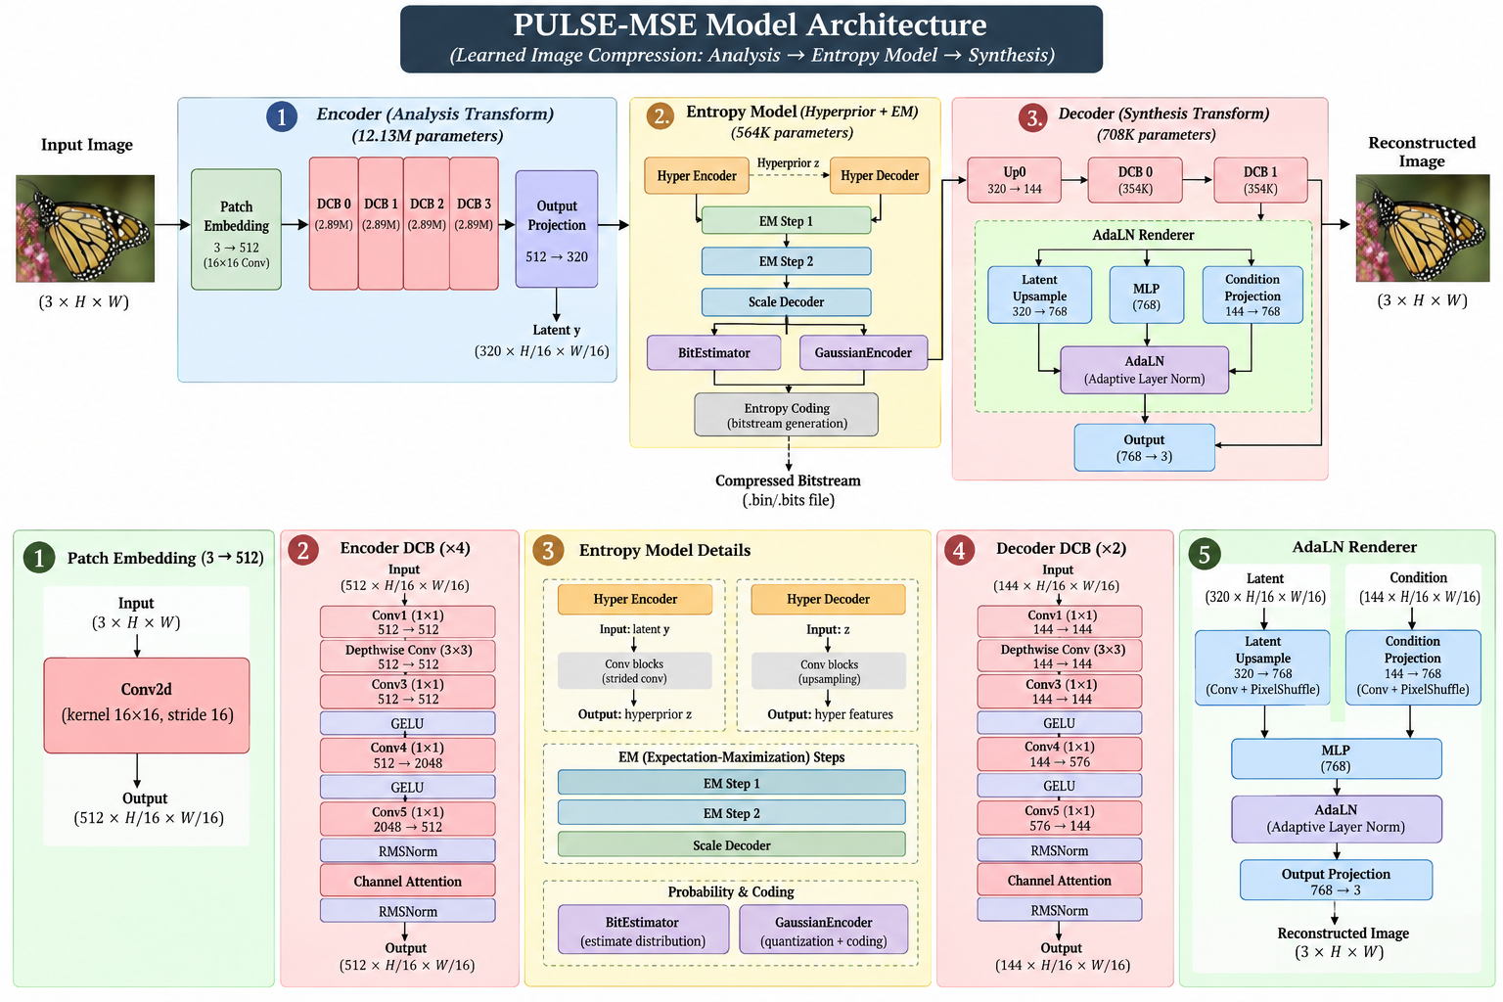
THE PAPER · ARCHITECTURE
PULSE architecture - considering their base model pulse-mse
1
2
3
4
CS6886 · IIT Madras — Source: Jia et al., arXiv:2609.18602
03 / 08
Notes:
Everything we do later hangs on callouts 2 and 4.

Slide 4
THE PAPER · EVALUATION
How PULSE was structured and tested (taking pulse-mse)
ENCODER · 12.13M params
ENTROPY MODEL · 1.34M params
DECODER · 0.71M params
Patch Embed 3→512
4 × DCB (512-channel)
Output Projection 512→320
Hyper Encoder / Decoder
EM Step 1 · EM Step 2
Scale Decoder + integer entropy control
320→144 projection
2 × DCB
AdaLN renderer
Hardware
Benchmarks & metrics
Reported results
Speed
· 1 thread of an AMD EPYC 9V84 server CPU
· Snapdragon 8 Elite phone NPU (REDMI K80 Pro)
Bit-exactness
· x86 CPU · ARM CPU · phone NPU · A100 / H100 GPUs
Training
· One NVIDIA H100: 15 h (MSE), 36 h (perceptual); 22 training runs for the whole architecture search
Data
· Kodak — 24 classic test photos, 768×512
· CLIC 2020 Professional validation — 41 high-res photos
Metrics
· PSNR & MS-SSIM vs. bpp at all 8 settings (rate–distortion curve)
· BD-rate vs. 8 separate models (extra % of bits at equal quality; 0% = equal)
· Latency at 1080p · stream-hash match across devices
· 1080p decode in 77 / 126 / 420 ms (S / Base / L) on one CPU thread
· Snapdragon NPU: 42 ms encode / 20 ms decode at 1080p
· Identical stream hashes across phone, laptop and server — 0 mismatches
· Matches HM on CLIC; −22.5% FID BD-rate vs. MS-ILLM (PULSE-L, perceptual)
Training data (paper, App. B): 4.8M crops from SAM-1B + Open Images at 512², then 4,035 high-res images at 1024² (800 DIV2K + 2,650 Flickr2K + 585 CLIC train). Training code is released — train_mse.py and recipes ship in the repo.
CS6886 · IIT Madras — Source: Jia et al., arXiv:2609.18602 §6, App. A–B
04 / 08
Notes:
Last line is our opening. They proved it runs on a phone and a server, not on an ordinary laptop GPU.

Slide 5
THE PAPER → OUR PLAN
The study we want to extend
The gap: laptop-GPU speed · 8-bit math in the big networks (FP16/BF16 today) · whether the quality setting changes 8-bit behavior · energy · where the time goes.
“
How does one INT8 configuration work across all 8 quality settings, how quantization sensitivity depend on QP and model component ?
”
So here we follow these 4 steps in order to reduce the risk on single approach
BASELINE
PRECISION
QAT
ILP
reproduce
FP16 / INT8
recover
optimize
METRICS WE USE
bpp
PSNR / ΔPSNR
per component latency
memory
energy
correctness
We're not claiming PULSE needs a GPU — the RTX 3050 is our measuring instrument; a realistic use is batch-encoding photos on a PC. And these are hunches, not claims: if both are wrong, that's still a result.
CS6886 · IIT Madras — One Model, Eight Quality Settings, Eight Bits
05 / 08
Notes:
These are hunches, not claims. If both are wrong, that's still a result.

Slide 6
OUR PLAN · DELIVERABLES
Deliverables at the end
D1
Reproduce and measure
PULSE reproduced on the 3050 at all 8 settings, As specified in their artifacts
Time Analysis breakdown(per each significant step done in the model running) and ensuring all the metrics are working.
D2
8-bit across quality settings
TensorRT FP16 / INT8 receiver engines, with a shared-vs-per-QP BD-rate table. - if any similar pattern found across a row or column then we have to look into it through D3.
D3
QAT - Quantization Aware Training (from the training sets they have mentioned)
We do this only if we are having very high loss on int8 PTQ at some particular components.
also we add extra testable image sets inorder to make the model bias towards test image sets. - we use tensorRT, PyTorch
D4
Finally - Standard ILP based mixed precision and then publishing the finalized model
We use Integer Linear programming to determine under which constraints and conditions of components - we are able to get the best results
we mainly be focussing on FP16, INT8 - we use Gurobi or Google OR-Tools (the approach will be based on HAWQ-V3)
we use variables - Latency, PSNR, Memory, Compute(BOPS/ kMAC/pxl), Energy
CS6886 · IIT Madras — One Model, Eight Quality Settings, Eight Bits
06 / 08
Notes:
Each deliverable stands on its own, so partial progress is still a real result.

Slide 7
THE PAPER · ARTIFACTS
What they open-sourced
Code — MIT license
pulse-mse/← every bundle has the same shape
├─ config.json
├─ model.pt# float networks
├─ entropy_control_int.pt# INT8 probability layer
├─ manifest.json
└─ SHA256SUMS# file fingerprints
github.com/microsoft/GenCodec → PULSE: ~6.6k lines of Python + C++, including training entry points (train_mse.py, pulse-train-*).
Weights — MIT license, 4 bundles
huggingface.co/zhaoyangjia/PULSE
pulse-s-mse — small receiver, tuned for PSNR
pulse-mse — base receiver, tuned for PSNR
pulse-perceptual — base receiver, tuned to look good
pulse-l-perceptual — large receiver, perceptual
Three ready-made runtimes
Single-thread C++ CPU
AVX-512 fast path for AMD EPYC, generic fallback
Scripts
H100 GPU runtime with CUDA graphs
A recorded GPU job replayed with one call — one graph per QP
download_models.py · compress.py · decompress.py · evaluate.py
evaluate.py reports per-QP bpp, PSNR, encode/decode ms, optional LPIPS / DISTS / FID.
Snapdragon path via ONNX export
encoder.onnx / decoder.onnx, fixed 1920×1088, QP as an input
Benchmark harness included: mean / median / p90 latency, stream SHA-256, determinism check.
CS6886 · IIT Madras — Source: github.com/microsoft/GenCodec (PULSE)
07 / 08
Notes:
That's a lot of ready-made scaffolding. We reuse it instead of rebuilding the codec.

Slide 8
CLOSE
References and credits
REFERENCES
[1] Jia, Zhang, Zheng, Xie, Li, Li, Li, Lu. PULSE: Unlocking Practical Image Compression on Single-Thread CPU. arXiv:2609.18602 (preprint) · github.com/microsoft/GenCodec · HF zhaoyangjia/PULSE
[2] Dong et al., HAWQ / V2 / V3 — ICCV 2019, NeurIPS 2020, ICML 2021 · VENOM, SC 2023 (course readings)
[3] Kamisli, Racapé, Choi. DCC 2024, arXiv:2402.18930 (fallback codec)
[4] Related 8-bit codec work: Ye et al., JVCIR 2025 · HaTQ, arXiv:2608.01653 · SenseTime, arXiv:2207.14524
[5] Tools: PyTorch · ONNX · TensorRT · NVML | Data: Kodak · CLIC 2020 · DIV2K
Questions welcome — [cs23b010@smail.iitm.ac.in]
CS6886 · IIT Madras — One Model, Eight Quality Settings, Eight Bits
08 / 08
Notes:
Takeaway: PULSE showed a neural codec can run on a phone. We're finding out how it behaves on an ordinary laptop GPU, and whether 8-bit works equally well at every quality setting.

